Slide 1
HLNS计算结果及Lagrange角度的思考
2024.4.11
Haoyu Lu

Slide 2
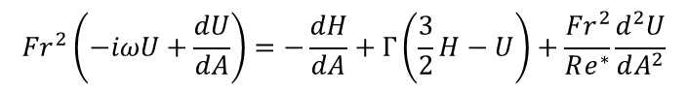
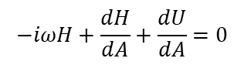
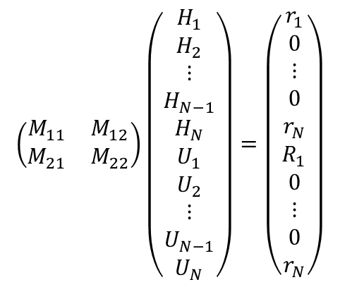
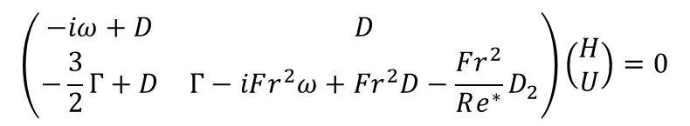

HLNS的实施过程
以2D沙子本构为例
$$−iωH+\frac{dH}{dA}+\frac{dU}{dA}=0$$
$${Fr}^{2}\left(−iωU+\frac{dU}{dA}\right)=−\frac{dH}{dA}+Γ\left(\frac{3}{2}H−U\right)+\frac{{Fr}^{2}}{Re^{∗}}\frac{d^{2}U}{dA^{2}}$$
$$\left(\begin{matrix}−iω+D & D \\ −\frac{3}{2}Γ+D & Γ−iFr^{2}ω+{Fr}^{2}D−\frac{Fr^{2}}{Re^{∗}}D_{2}\end{matrix}\right)\left(\begin{matrix}H \\ U\end{matrix}\right)=0$$
$$\left(\begin{matrix}M_{11} & M_{12} \\ M_{21} & M_{22}\end{matrix}\right)\left(\begin{matrix}H_{1} \\ \begin{aligned}H_{2} \\ ⋮ \\ H_{N−1} \\ H_{N} \\ U_{1} \\ U_{2} \\ ⋮ \\ U_{N−1} \\ U_{N}\end{aligned}\end{matrix}\right)=\left(\begin{matrix}r_{1} \\ \begin{aligned}0 \\ ⋮ \\ 0 \\ r_{N} \\ R_{1} \\ 0 \\ ⋮ \\ 0 \\ r_{N}\end{aligned}\end{matrix}\right)$$
在$M$矩阵中代入空间模式局部解得到的扰动点（$\{−k_{i}\}$）对应的$ω$的值
其中$r_{1}$,$R_{1}入口$条件由局部解的特征值对应的特征函数给出
$r_{N}$,$R_{N}右边界$具体取什么不影响解的形式（只影响右侧边界上很短的区域）
转化成$Ax=b$问题

Slide 3
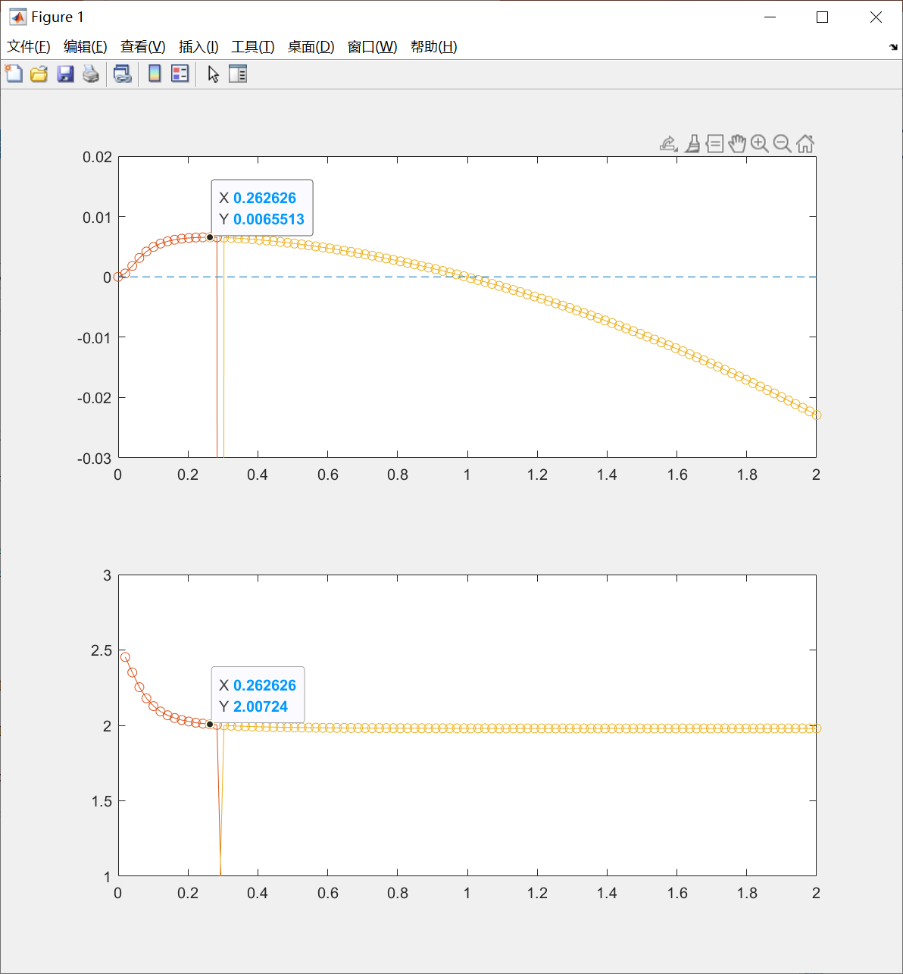
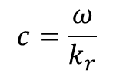
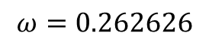
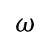
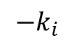
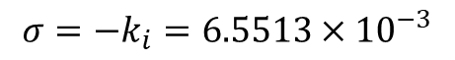
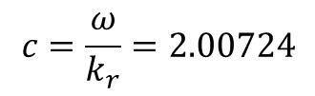
2D空间模式的局部解
$$−k_{i}$$
选择增长率最高点的参数
$$ω=0.262626$$
$$σ=−k_{i}=6.5513×{10}^{−3}$$
$$c=\frac{ω}{k_{r}}=2.00724$$
$$c=\frac{ω}{k_{r}}$$
$$ω$$

Slide 4
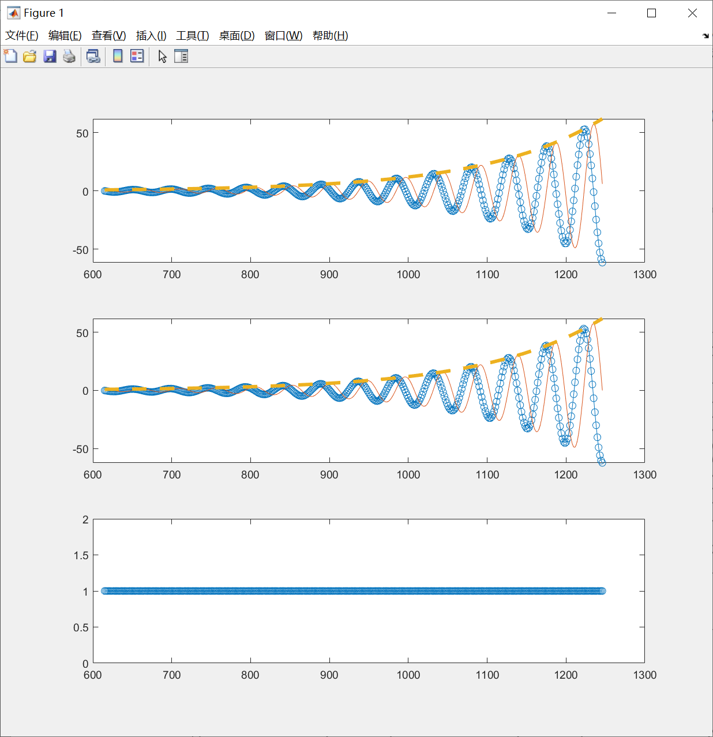
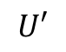

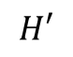
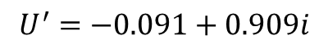

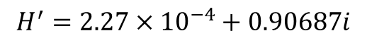
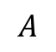
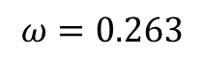
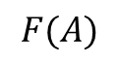
简化到二维平板的沙子流动的
HLNS
Real – 蓝线
Imag – 橙线
Abs – 黄线
$$H′$$
局部解算得的$k$
$$k=0.131−0.00655i$$
$$U′$$
入口参数（用空间模式的局部解给出）
$$ω=0.263$$
$$H^{′}=2.27×{10}^{−4}+0.90687i$$
$$U^{′}=−0.091+0.909i$$
$$F(A)$$
$$A$$

Slide 5
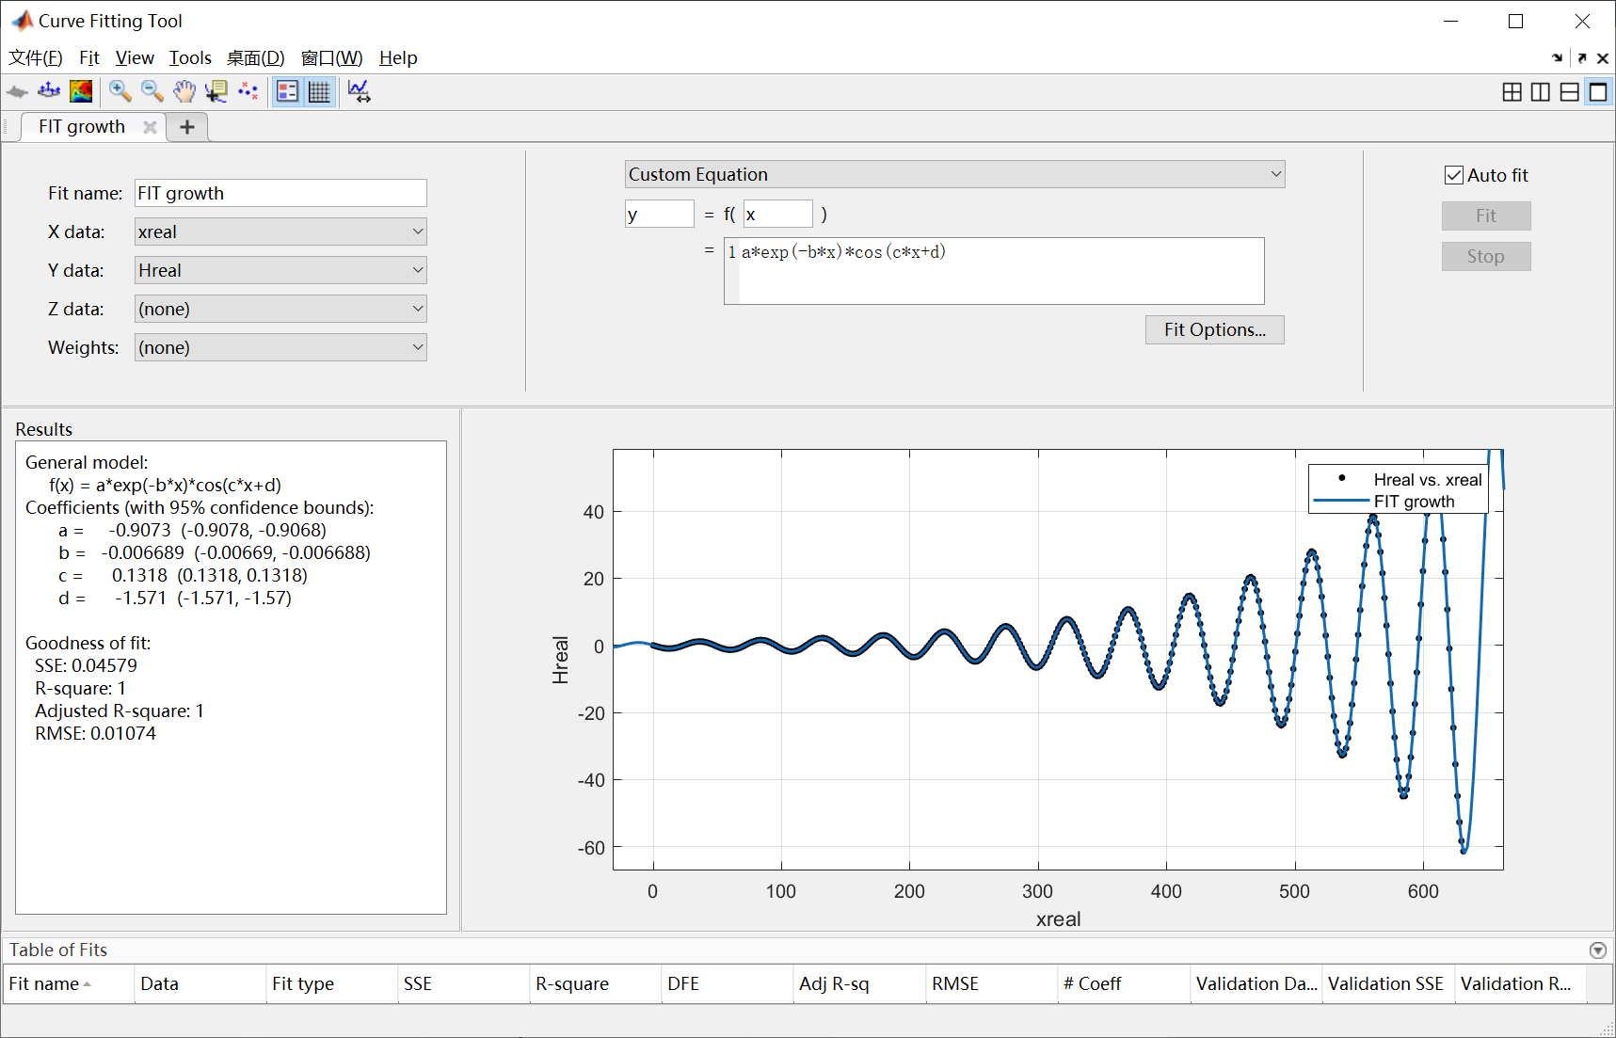
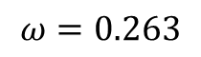
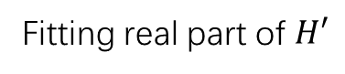

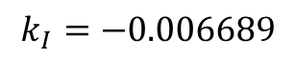
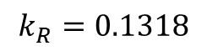
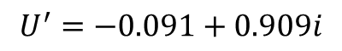
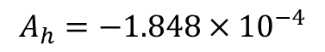
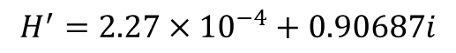
Fitting real part of $H′$
$$A_{h}=−1.848×{10}^{−4}$$
$$k_{R}=0.1318$$
$$k_{I}=−0.006689$$
入口参数
$$k=0.131−0.00655i$$
$$H^{′}=2.27×{10}^{−4}+0.90687i$$
$$ω=0.263$$
$$U^{′}=−0.091+0.909i$$

Slide 6
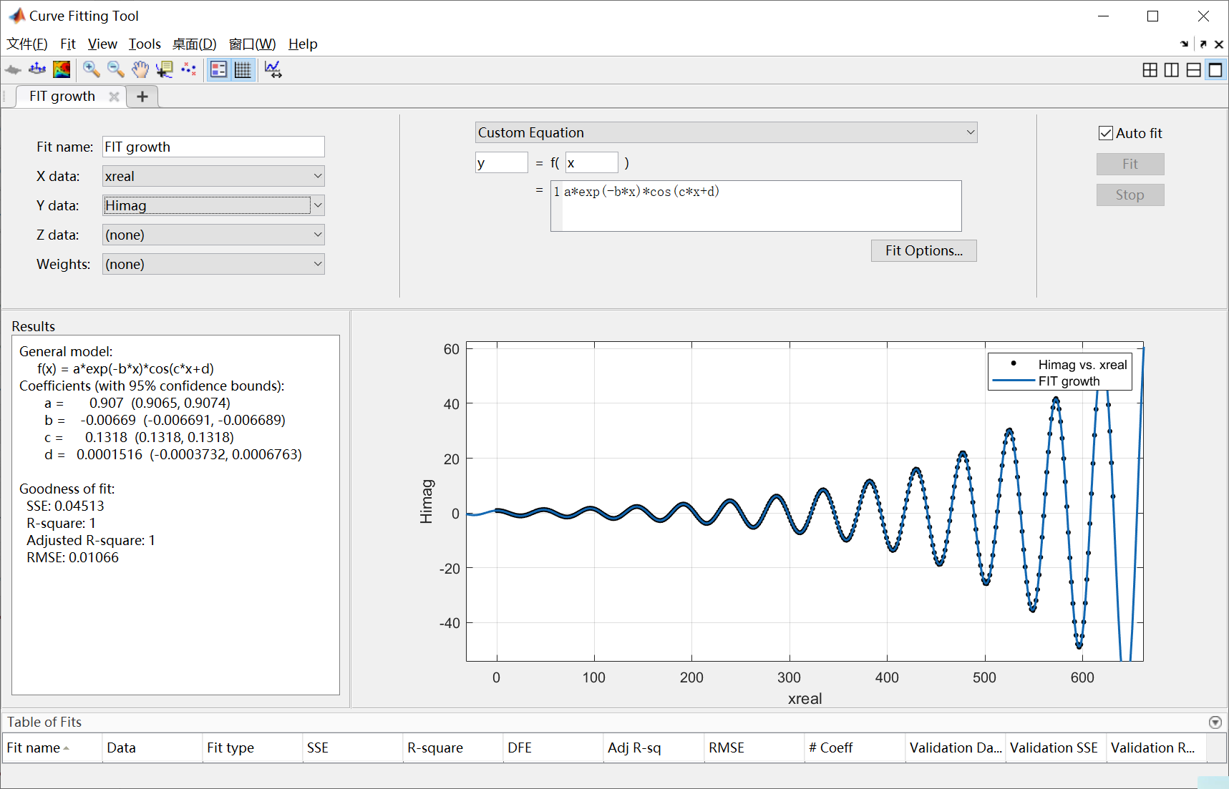
Imag part

Slide 7
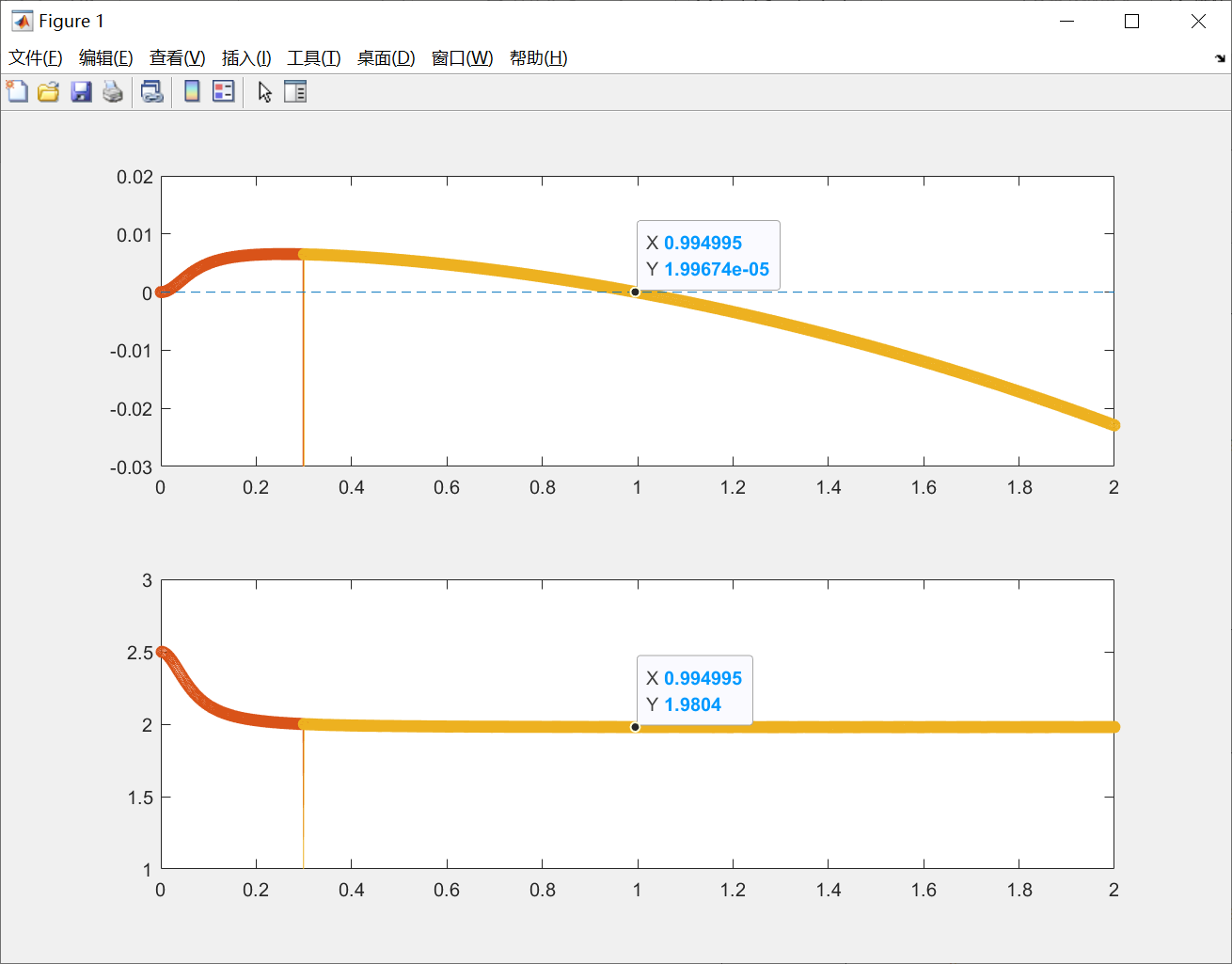
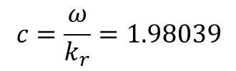
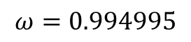
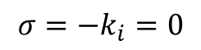
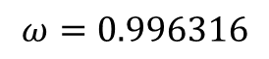
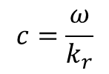
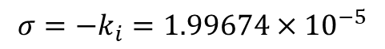
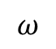
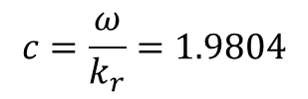
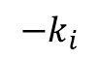
2D空间模式的局部解
近似的中性点
$$ω=0.994995$$
$$σ=−k_{i}=1.99674×{10}^{−5}$$
$$−k_{i}$$
$$c=\frac{ω}{k_{r}}=1.9804$$
$$ω=0.996316$$
$$σ=−k_{i}=0$$
$$c=\frac{ω}{k_{r}}=1.98039$$
$$c=\frac{ω}{k_{r}}$$
$$ω$$

Slide 8
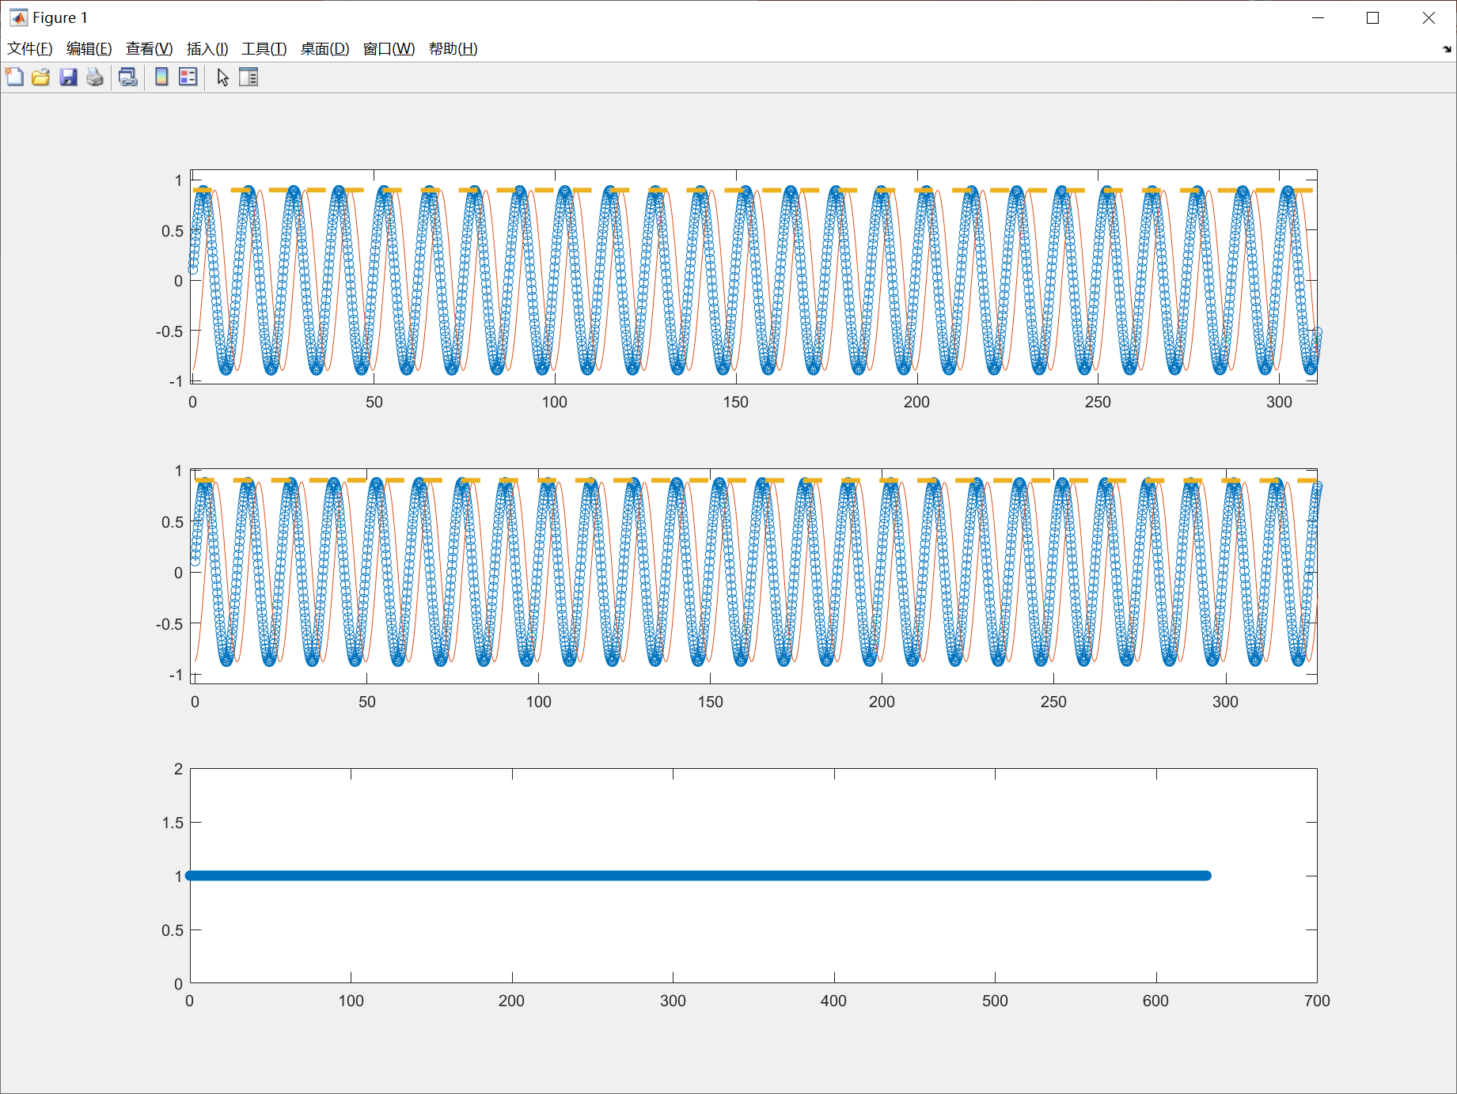

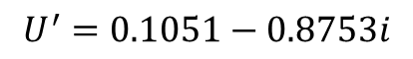

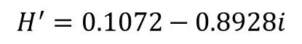
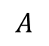
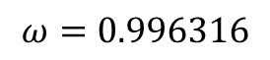
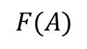
简化到二维平板的沙子流动的
HLNS
Real – 蓝线
Imag – 橙线
Abs – 黄线
$$H′$$
局部解算得的$k$
$$k=0.5031−0.0000i$$
入口参数（用空间模式的局部解给出）
$$U′$$
$$ω=0.996316$$
$$H^{′}=0.1072−0.8928i$$
$$U^{′}=0.1051−0.8753i$$
$$F(A)$$
$$A$$

Slide 9
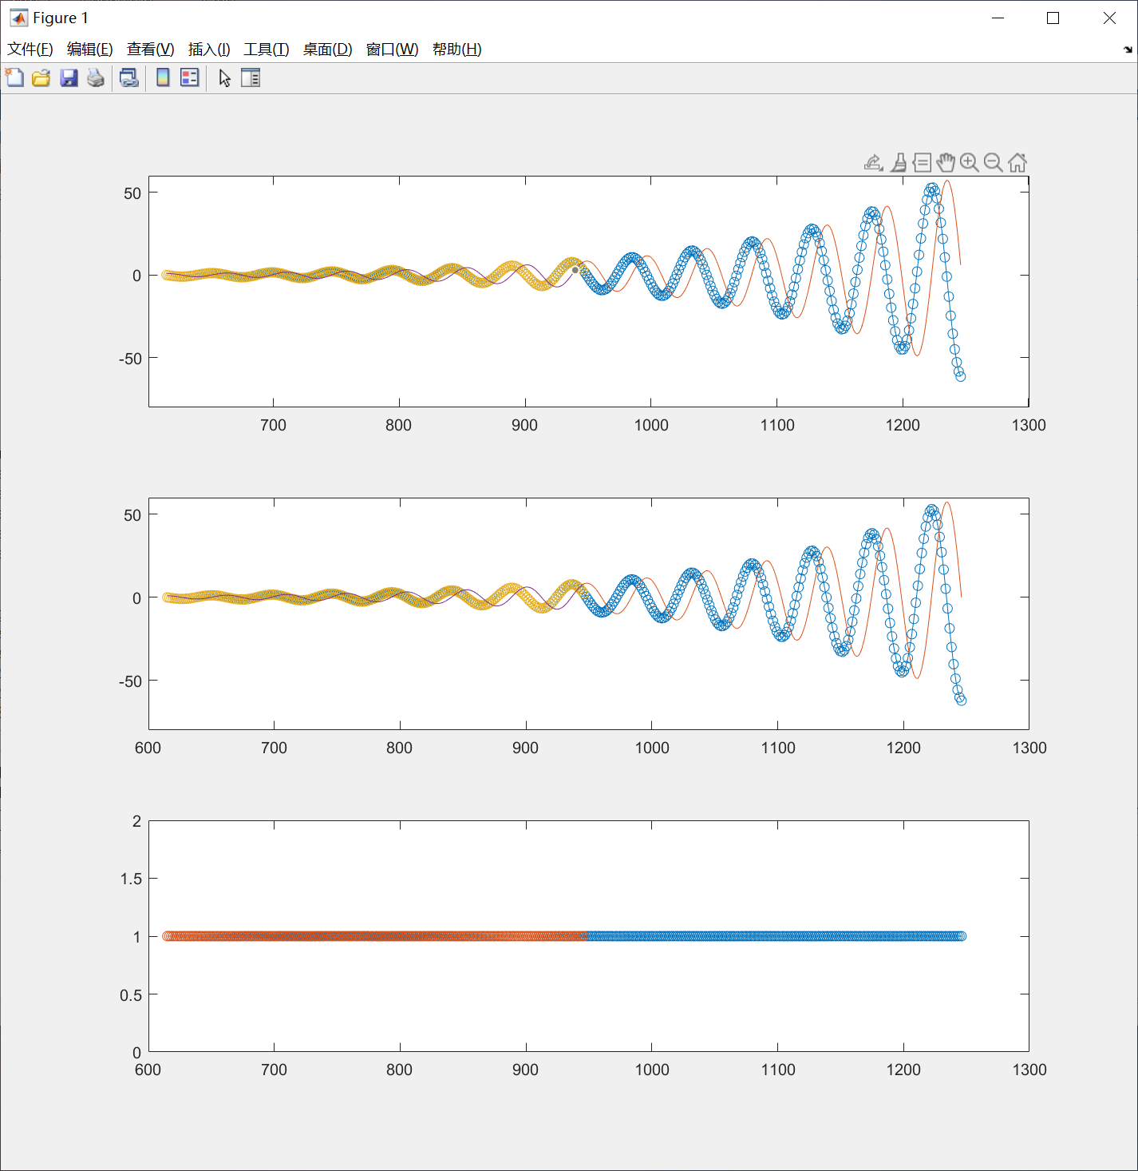
计算域伸缩的不变性

Slide 10
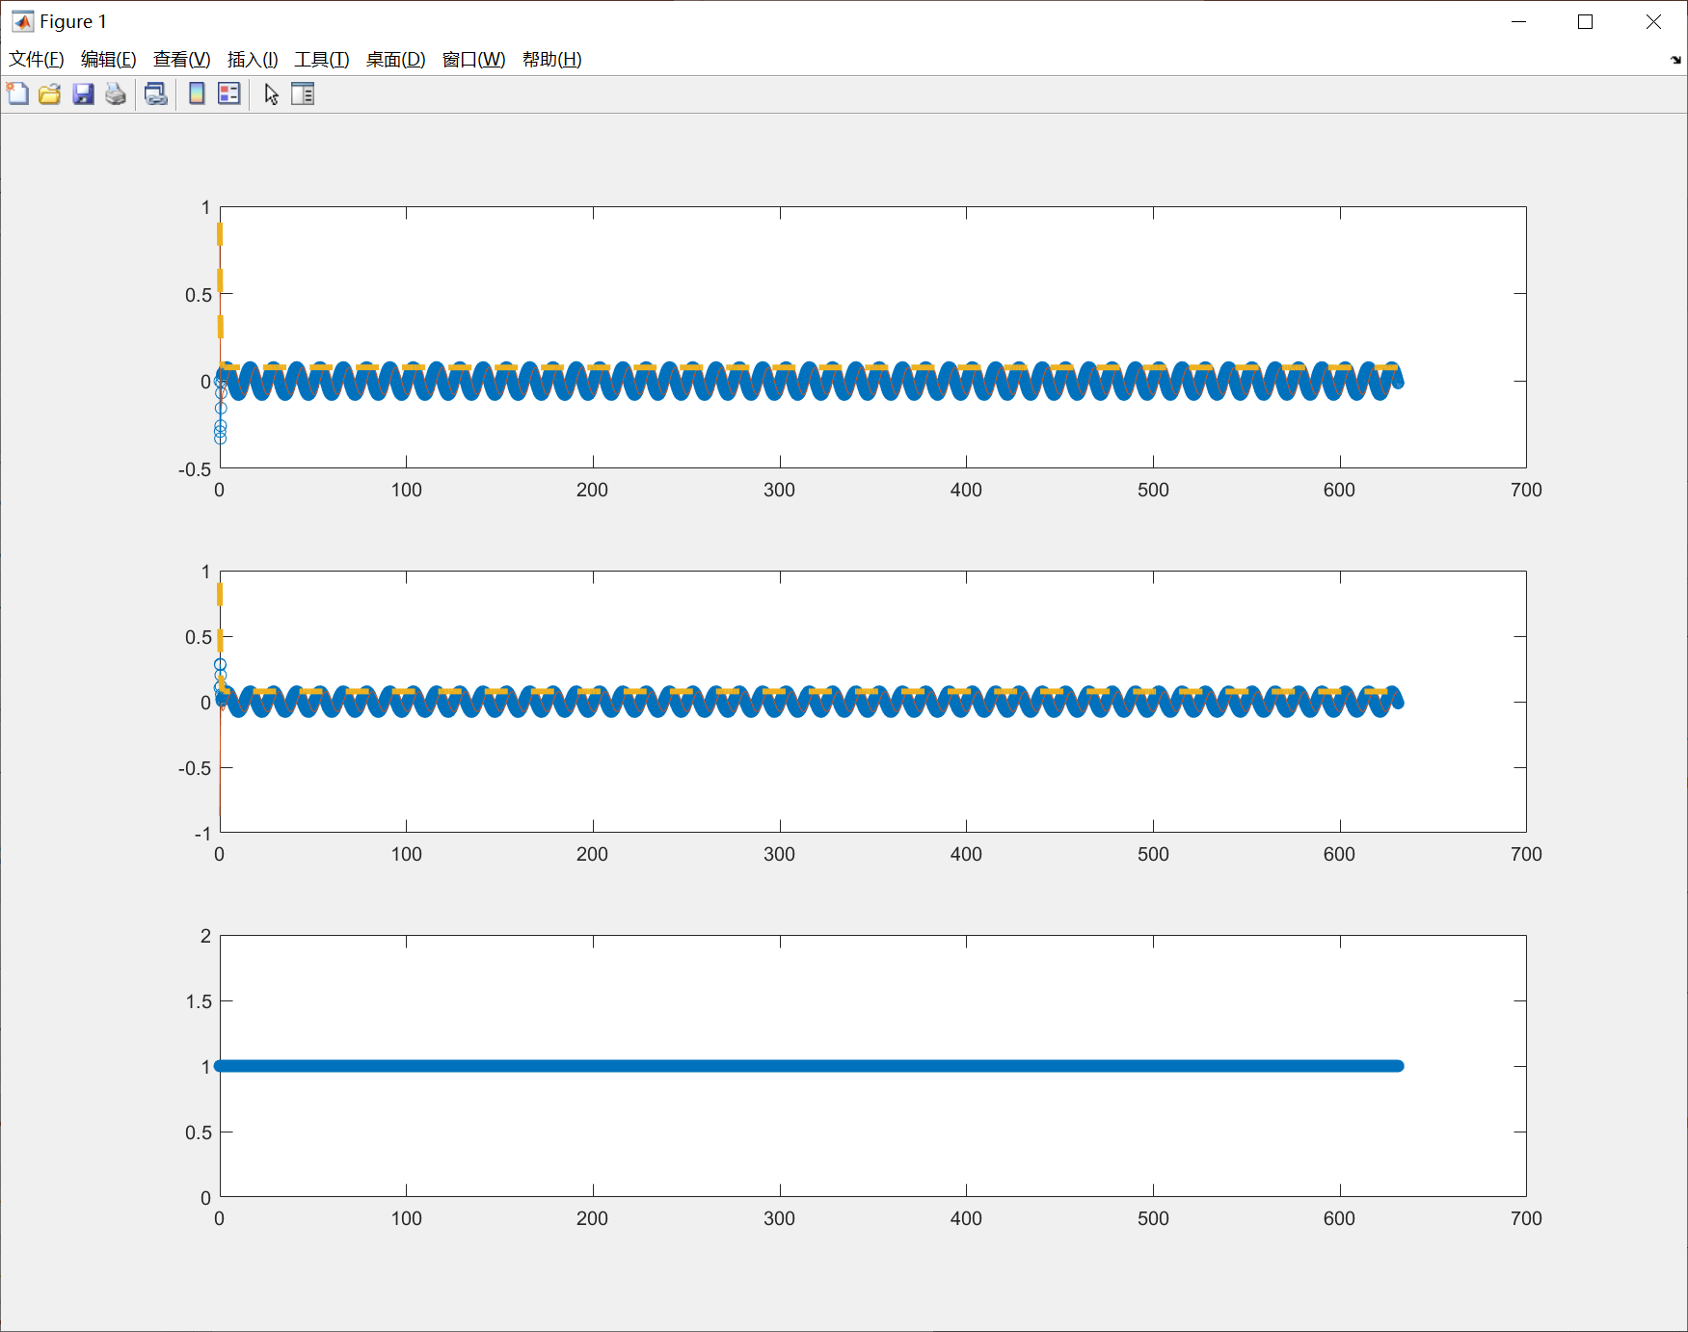
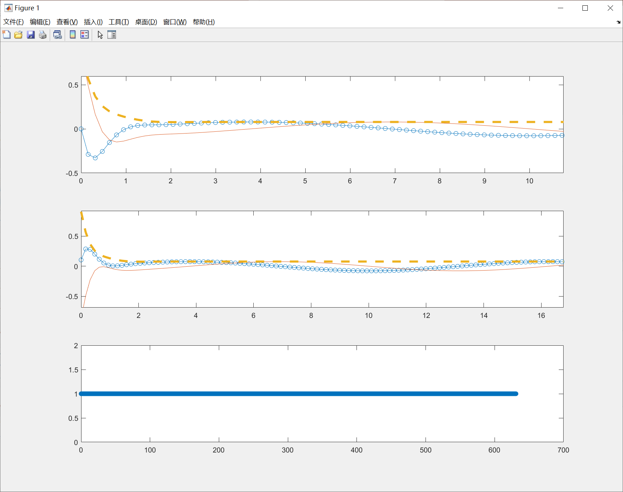

在中性点给进方程的$ω$不变的情况下
故意给错入口边界条件

Slide 11
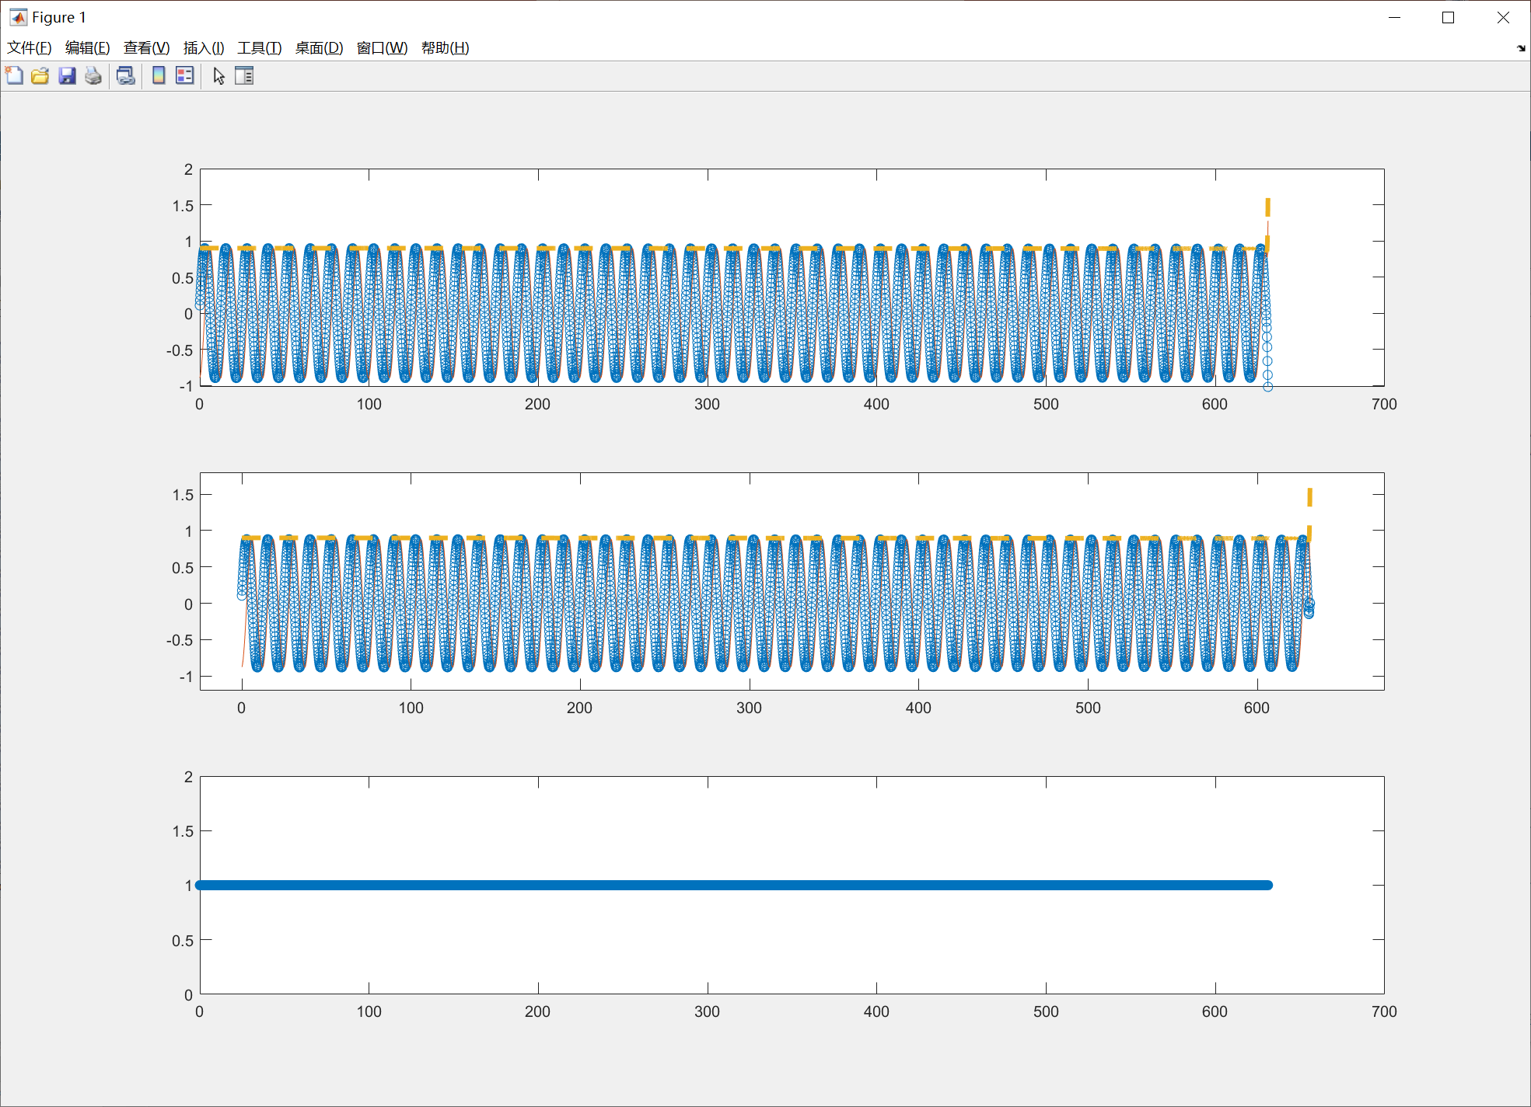
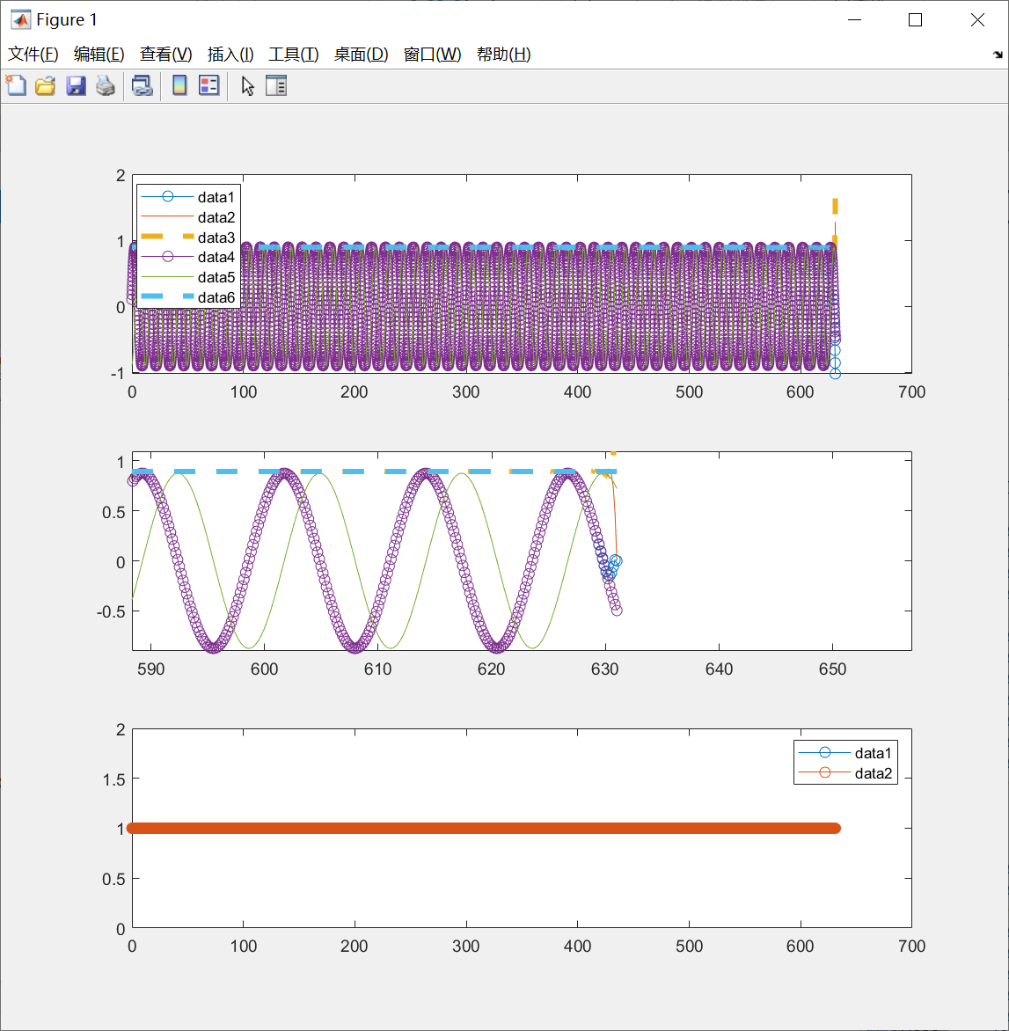
出口边界条件强制给出
对前端区域没有影响

Slide 12
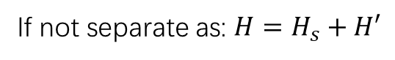








$Lagrangian view^{[1]} in constructing solutions for the shape of granular roll waves$
$$μ_{b}=μ_{b}\left(H,U\right)=\tan{α_{1}}+\frac{\tan{α_{2}}−\tan{α_{1}}}{1+γ\frac{H^{\frac{3}{2}}}{U}}$$
$$\frac{∂H}{∂T}+\frac{∂}{∂A}(HU)=0$$
$$\frac{∂U}{∂T}+U\frac{∂U}{∂A}=−\frac{1}{Fr^{2}}\frac{∂H}{∂A}+\frac{1}{Fr^{2}}\left({\tan{α−μ}}_{b}\right)+\frac{1}{Re^{∗}}\frac{∂}{∂A}\left(H^{\frac{3}{2}}\frac{∂U}{∂A}\right)$$
$$Re^{∗}=\frac{U_{s}\sqrt{H_{s}}}{ν}$$
$$Fr=\frac{U_{s}}{\sqrt{gH_{s}\cos{α}}}$$
If not separate as: $H=H_{s}+H′$
Just switching to a moving frame that moves at the same speed $u_{w}$
New coordinate:
$$ξ=A−u_{w}T$$
Governing eqns. become
$$\frac{d}{dξ}\left(H\left(U−u_{w}\right)\right)=0$$
$$\left(U−u_{w}\right)\frac{dU}{dξ}=−\frac{1}{Fr^{2}}\frac{dH}{dξ}+\frac{1}{Fr^{2}}\left(\tan{α}−μ_{b}\right)+\frac{1}{Re^{∗}}\frac{d}{dξ}\left(H^{\frac{3}{2}}\frac{dU}{dξ}\right)$$
[1] Gray, J. M. N. T. and A. N. Edwards. “A depth-averaged mu(I)-rheology for shallow granular free-surface flows.” Journal of Fluid Mechanics 755 (2014): 503-534.

Slide 13












$$\frac{d}{dξ}\left(H\left(U−u_{w}\right)\right)=0$$
$$(1)$$
$$\left(U−u_{w}\right)\frac{dU}{dξ}=−\frac{1}{Fr^{2}}\frac{dH}{dξ}+\frac{1}{Fr^{2}}\left(\tan{α}−μ_{b}\right)+\frac{1}{Re^{∗}}\frac{d}{dξ}\left(H^{\frac{3}{2}}\frac{dU}{dξ}\right)$$
$$(2)$$
Infty $→$ uniform flow: $U=U_{s}(∞)=1 ;H=H_{s}(∞)=1$ must be a solution of these eqns.
From $(1)$ we can get:
$$U=u_{w}+\frac{1−u_{w}}{H}$$
$$(3)$$
$$H\left(U−u_{w}\right)=1∗(1−u_{w})$$
Plug $(3)$ into $(2)$ to obtain the equation that only contain $H=H(ξ)$ (If we can set $u_{w}$ manually)
$$\frac{d^{2}H}{dξ^{2}}=\frac{1}{2H}{\left(\frac{dH}{dξ}\right)}^{2}+\frac{Re^{∗}}{Fr^{2}(u_{w}−1)}H^{\frac{3}{2}}\left[\left(1−\frac{Fr^{2}{\left(u_{w}−1\right)}^{2}}{H^{3}}\right)\frac{dH}{dξ}−\tan{α}+μ\right]$$
$$μ=μ\left(H\right)=\tan{α_{1}}+\left(\tan{α_{2}}−\tan{α_{1}}\right)\frac{1−u_{w}+u_{w}H}{1−u_{w}+u_{w}H+γH^{\frac{5}{2}}}$$
$$\frac{dH}{dξ}{\left.​\right|}_{int} =0$$
Become a initial value problem
$$H_{int}=1$$

Slide 14









$$\frac{d^{2}H}{dξ^{2}}=\frac{1}{2H}{\left(\frac{dH}{dξ}\right)}^{2}+\frac{Re^{∗}}{Fr^{2}(u_{w}−1)}H^{\frac{3}{2}}\left[\left(1−\frac{Fr^{2}{\left(u_{w}−1\right)}^{2}}{H^{3}}\right)\frac{dH}{dξ}−\tan{α}+μ\right]$$
$$μ=μ\left(H\right)=\tan{α_{1}}+\left(\tan{α_{2}}−\tan{α_{1}}\right)\frac{1−u_{w}+u_{w}H}{1−u_{w}+u_{w}H+γH^{\frac{5}{2}}}$$
$$\frac{dH}{dξ}{\left.​\right|}_{int} =0$$
Become a initial value problem
$$H_{int}=1$$
Use ode45 in MATLAB to solve it from the beginning
$$H$$
$$ξ$$

Slide 15



$$\frac{dH}{dξ}$$
$$H$$

Slide 16





$$\frac{dH}{dξ}$$
$$ξ$$

Slide 17

HLNS计算结果和Lagrangian view计算得到的profile不一致
形函数 与 真实剖面？

Slide 18








$$Lagrangian view in water$$
$$ξ=A−u_{w}T$$
$$\frac{d}{dξ}\left(H\left(U−u_{w}\right)\right)=0$$
$$U=u_{w}+\frac{1−u_{w}}{H}$$
$$\left(U−u_{w}\right)\frac{dU}{dξ}=−\frac{1}{Fr^{2}}\frac{dH}{dξ}+\frac{1}{Fr^{2}}\left(\tan{α}−\frac{Fr^{2}}{Re}\frac{3U}{H^{2}} \right)+\frac{1}{Re}\frac{d^{2}U}{dξ^{2}}$$
$μ_{b}$ in water model
$$\frac{d^{2}H}{dξ^{2}}=\frac{2}{H}{\left(\frac{dH}{dξ}\right)}^{2}+\frac{Re}{Fr^{2}(u_{w}−1)}H^{2}\left[\left(1−\frac{F^{2}{\left(u_{w}−1\right)}^{2}}{H^{3}}\right)\frac{dH}{dξ}−\tan{α}+μ_{b}\right]$$
$$μ_{b}=\frac{Fr^{2}}{Re}\frac{3}{H^{2}}\left(u_{w}+\frac{1−u_{w}}{H}\right)$$
Compare with that in sand model
$$\frac{d^{2}H}{dξ^{2}}=\frac{1}{2H}{\left(\frac{dH}{dξ}\right)}^{2}+\frac{Re^{∗}}{Fr^{2}(u_{w}−1)}H^{\frac{3}{2}}\left[\left(1−\frac{Fr^{2}{\left(u_{w}−1\right)}^{2}}{H^{3}}\right)\frac{dH}{dξ}−\tan{α}+μ_{b}\right]$$
$$μ_{b}=μ\left(H\right)=\tan{α_{1}}+\left(\tan{α_{2}}−\tan{α_{1}}\right)\frac{1−u_{w}+u_{w}H}{1−u_{w}+u_{w}H+γH^{\frac{5}{2}}}$$

Slide 19

















水的Lagrangian view结果
$$H$$
$$u_{w}=2.2730$$
$$ξ$$
$$\frac{dH}{dξ}$$
No limiting cycle
$$H$$
$$u_{w}=2.2734$$
$$H$$
$$ξ$$
Gradually have limiting cycle
$$\frac{dH}{dξ}$$
$$H$$
Become a initial value problem
$$H_{int}=1$$
$$\frac{dH}{dξ}{\left.​\right|}_{int} =0$$

Slide 20







水的Lagrangian view结果
$$u_{w}=2.2737$$
$$H$$
Have limiting cycle
Grow up to stability
$$ξ$$
$$\frac{dH}{dξ}$$
$$H$$
water
sand

Slide 21



水的Lagrangian view结果
If continue to increase $u_{w}$, greater than the limit value $1+\frac{1}{F}$
$$u_{w}=2.4737$$

Slide 22
HLNS求解精度的提升方向
1. 网格点数N上升（对特定$的ω=ω_{f}，$N必须大于阈值才可以计算出合理的解）
2. 差分矩阵：目前仍然是左边界向前差分，中心点中心差分，并且全都是二阶精度
未来可以换成向前差分矩阵以及四阶精度
研究方向询问：
暂时想做一下沙子二维模型，考虑基本流变化的非平行性效应，然后看在下游能不能和上文的解对上
如果能再扩展到三维（引入周向的动量方程）

Slide 23









$$\frac{∂H}{∂T}+U\frac{∂H}{∂A}+H\frac{∂U}{∂A}+\frac{HU}{A}=0$$
$$\frac{∂U}{∂T}+U\frac{∂U}{∂A}−\frac{U^{2}}{A}=−\frac{1}{F^{2}}\frac{∂H}{∂A}+\frac{1}{F^{2}}\left(\tan{α−μ}\right)+\frac{1}{R}\left(\frac{3}{2}H^{−\frac{1}{2}}\frac{∂H}{∂A}\frac{∂U}{∂A}+H^{\frac{1}{2}}\frac{∂^{2}U}{∂A^{2}}\right)$$
Apply perturbation assumptions:
$$H=H_{s}+H′$$
$$U=U_{s}+U′$$
除了系数上的修正，还有额外的项添加进来
$$\frac{∂H^{′}}{∂T}+H_{S}\frac{∂U^{′}}{∂A}+U_{s}\frac{∂H^{′}}{∂A}+\left(\frac{∂H_{s}}{∂A}+\frac{H_{s}}{A}\right)U^{′}+\left(\frac{∂U_{s}}{∂A}+\frac{U_{s}}{A}\right)H^{′}=0$$
$$\frac{∂U^{′}}{∂T}+U_{s}\frac{∂U^{′}}{∂A}+\left(\frac{∂U_{s}}{∂A}−\frac{2U_{s}}{A}\right)U^{′}=−\frac{1}{F^{2}}\frac{∂H^{′}}{∂A}+\frac{\tan{α_{2}}−\tan{α_{1}}}{F^{2}}\frac{γ^{∗}}{1+γ^{∗}}\left(−\frac{U^{′}}{U_{s}}+\frac{3}{2}\frac{H^{′}}{H_{s}}\right)$$
$$+\frac{1}{R}\frac{3}{2}H_{s}^{−\frac{1}{2}}\frac{∂U_{s}}{∂A}\frac{∂H^{′}}{∂A}+\frac{1}{R}\frac{3}{2}H_{s}^{−\frac{1}{2}}\frac{∂H_{s}}{∂A}\frac{∂U^{′}}{∂A}+\frac{1}{R}\left(−\frac{3}{4}H_{s}^{−\frac{3}{2}}\frac{∂H_{s}}{∂A}\frac{∂U_{s}}{∂A}+\frac{1}{2}H_{s}^{−\frac{1}{2}}\frac{∂^{2}U_{s}}{∂A^{2}}\right)H′$$
$$+\frac{1}{R}H_{s}^{\frac{1}{2}}\frac{∂^{2}U^{′}}{∂A^{2}}$$
$$γ^{∗}=γ\frac{H_{s}^{\frac{3}{2}}}{U_{s}}$$
$$R=\frac{u_{0}\sqrt{h_{0}}}{ν}$$
$$ν=\frac{2}{9}\frac{L\sqrt{g}}{β}\frac{\sin{α}}{\sqrt{\cos{α}}}\left(\frac{\tan{α_{2}}−\tan{α}}{\tan{α}−\tan{α_{1}}}\right)$$
where
$$F=\frac{u_{0}}{gh_{0}\cos{α}}$$

Slide 24











解 近似$A→∞$处（后端）的水的扰动方程
目的是简化方程，基本流$\frac{{dU}_{s}}{dA},\frac{{dH}_{s}}{dA}\sim 0$
$$\frac{dH′}{dA}+\frac{dU′}{dA}+i\frac{k_{2}}{A\cos{ξ}}V^{′}=iωH′$$
$$SPT_{j}=i\frac{k_{2}}{A_{j}\cos{ξ}}$$
$$\frac{∂H^{′}}{∂T}+\frac{∂H^{′}}{∂A}+\frac{∂U′}{∂A}+\frac{1}{X_{2}}\frac{∂V′}{∂θ}=0$$
代入扰动展开式
$$\frac{dU^{′}}{dA}+\frac{1}{Fr^{2}}\frac{dH^{′}}{dA}−\frac{1}{Re}\frac{d^{2}U^{′}}{dA^{2}}+\frac{3}{R}U^{′}−\frac{6}{R}H^{′}=iωU′$$
$$\frac{∂U′}{∂T}+\frac{∂U′}{∂A}=−\frac{1}{Fr^{2}}\frac{∂H^{′}}{∂A}+\frac{1}{Re}\left[\frac{∂}{∂A}\left(\frac{∂U^{′}}{∂A}\right)+{\left(\frac{1}{X_{2}}\right)}^{2}\frac{∂}{∂θ}\left(\frac{∂U^{′}}{∂θ}\right)\right]+\frac{1}{Re}\left(−3U′+6H′\right)$$
$$\frac{∂V′}{∂T}+\frac{∂V′}{∂A}=−\frac{1}{Fr^{2}}\frac{1}{X_{2}}\frac{∂H^{′}}{∂θ}+\frac{1}{Re}\left[\frac{∂}{∂A}\left(\frac{∂V^{′}}{∂A}\right)+{\left(\frac{1}{X_{2}}\right)}^{2}\frac{∂}{∂θ}\left(\frac{∂V^{′}}{∂θ}\right)\right]−\frac{3}{Re}V′$$
$$\frac{dV^{′}}{dA}+\frac{1}{Fr^{2}}\frac{ik_{2}}{A\cos{ξ}}H^{′}−\frac{1}{Re}\frac{d^{2}V^{′}}{dA^{2}}+\frac{3}{R}V^{′}=iωV′$$
If $k_{2}=0$, simplified to 2D uniform incline problem
$$SPT=0$$
$$\left(\begin{matrix}D & D & SPT \\ \frac{1}{F^{2}}D−\frac{6}{R} & D−\frac{1}{R}D_{2}+\frac{3}{R} & 0 \\ \frac{1}{F^{2}}SPT & 0 & D−\frac{1}{R}D_{2}+\frac{3}{R}\end{matrix}\right)\left(\begin{matrix}H^{′} \\ U^{′} \\ V^{′}\end{matrix}\right)=iω\left(\begin{matrix}I & 0 & 0 \\ 0 & I & 0 \\ 0 & 0 & I\end{matrix}\right)\left(\begin{matrix}H^{′} \\ U^{′} \\ V^{′}\end{matrix}\right)$$

Slide 25









周期性边界条件
时间模式离散求解 水2D model
$$H′$$
$$ω_{i}$$
$$U′$$
$$ω_{r}$$
$$F(A)$$
$$A$$

Slide 26
Appendix

Slide 27

N=649
N=449

Slide 28










关于$u_{w}的$选择推荐值
$$u_{w}\sim 1+\frac{1}{Fr}$$
不动点问题的限制
$$\frac{dφ}{dξ}=Bφ$$
对于$B$的特征值
若要有limit cycle围绕着不动点转动，则
$Δ>0$: saddle (no limit cycle)
$Δ=0$: singular (no limit cycle)
$Δ<0$: exist limit cycle

Slide 29








How to constrain the value of $u_{w}$?
$$μ=μ\left(H\right)=\tan{α_{1}}+\left(\tan{α_{2}}−\tan{α_{1}}\right)\frac{1−u_{w}+u_{w}H}{1−u_{w}+u_{w}H+γH^{\frac{5}{2}}}$$
$$\frac{d^{2}H}{dξ^{2}}=\frac{1}{2H}{\left(\frac{dH}{dξ}\right)}^{2}+\frac{Re^{∗}}{Fr^{2}(u_{w}−1)}H^{\frac{3}{2}}\left[\left(1−\frac{Fr^{2}{\left(u_{w}−1\right)}^{2}}{H^{3}}\right)\frac{dH}{dξ}−\tan{α}+μ\right]$$
Separate $H$ into base flow and perturbation flow: $H=H_{s}+H^{′}=1+H′$
Here denote $N=\frac{dH}{dξ}$, thus the uniform base flow also gives the condition: $N=N_{s}+N^{′}=0+N′$
Thus we can get the perturbation equation:
Apply the reduction method:
$$φ={\left(H^{′},N^{′}\right)}^{T}$$
$$\frac{d^{2}H^{′}}{dξ^{2}}=\frac{Re^{∗}Γ\left(2u_{w}−5\right)}{2Fr^{2}(u_{w}−1)}H^{′}+\frac{Re^{∗}\left[1−Fr^{2}{\left(u_{w}−1\right)}^{2}\right]}{Fr^{2}\left(u_{w}−1\right)}\frac{dH^{′}}{dξ}$$
$$\frac{dφ}{dξ}=Bφ$$
$$B=\left(\begin{matrix}0 & 1 \\ \frac{Re^{∗}Γ\left(2u_{w}−5\right)}{2Fr^{2}(u_{w}−1)} & \frac{Re^{∗}\left[1−Fr^{2}{\left(u_{w}−1\right)}^{2}\right]}{Fr^{2}\left(u_{w}−1\right)}\end{matrix}\right)$$
$$\left(D∗I−B\right)φ=0$$

Slide 30










2D沙子模型下，考虑基本流的变化
$$\frac{∂U_{s}}{∂A}≠0$$
$$\frac{∂H_{s}}{∂A}≠0$$
$$U_{s}=U_{s}\left(A\right)≥1=U_{end}$$
$A$不再足够大，引入非平行性效应
$$H_{s}=H_{s}\left(A\right)≥1=H_{end}$$
Dimensional governing eqns.
$$\frac{∂h}{∂t}+\frac{∂}{∂a}\left(hu\right)+\frac{hu}{a}=0$$
$$\frac{∂}{∂t}\left(hu\right)+\frac{∂}{∂a}\left(χhu^{2}\right)=−\frac{∂}{∂a}\left(\frac{1}{2}gh^{2}\cos{α}\right)+hgS+\frac{∂}{∂a}\left(νh^{\frac{3}{2}}\frac{∂u}{∂a}\right)$$
Where $S=\cos{α}\left(\tan{α−μ}\right)−\cos{α}\frac{∂b}{∂a}$
$$μ=\tan{α_{1}}+\left(\tan{α_{2}}−\tan{α_{1}}\right)\frac{1}{1+γ\frac{H^{\frac{3}{2}}}{U}}$$
$$ν=\frac{2}{9}\frac{L\sqrt{g}}{β}\frac{\sin{α}}{\sqrt{\cos{α}}}\left(\frac{\tan{α_{2}}−\tan{α}}{\tan{α}−\tan{α_{1}}}\right)$$

Slide 31









将连续性方程代入动量方程，消去$∂h/∂t项，$得到新的非守恒形式的方程组
$$\frac{∂h}{∂t}+u\frac{∂h}{∂a}+h\frac{∂u}{∂a}+\frac{hu}{a}=0$$
$$h\frac{∂u}{∂t}+hu\frac{∂u}{∂a}−\frac{hu^{2}}{a}=−gh\cos{α}\frac{∂h}{∂a}+hg\cos{α}\left(\tan{α−μ}\right)+\frac{3}{2}νh^{\frac{1}{2}}\frac{∂h}{∂a}\frac{∂u}{∂a}+νh^{\frac{3}{2}}\frac{∂^{2}u}{∂a^{2}}$$
$$t=\frac{h_{0}}{u_{0}}T$$
Apply nondimensionalization
$$\left(h,a\right)=h_{0}(H,A)$$
$$u=u_{0}U$$
$$\frac{∂H}{∂T}+U\frac{∂H}{∂A}+H\frac{∂U}{∂A}+\frac{HU}{A}=0$$
$$\frac{∂U}{∂T}+U\frac{∂U}{∂A}−\frac{U^{2}}{A}=−\frac{1}{F^{2}}\frac{∂H}{∂A}+\frac{1}{F^{2}}\left(\tan{α−μ}\right)+\frac{1}{R}\left(\frac{3}{2}H^{−\frac{1}{2}}\frac{∂H}{∂A}\frac{∂U}{∂A}+H^{\frac{1}{2}}\frac{∂^{2}U}{∂A^{2}}\right)$$
$$μ=\tan{α_{1}}+\left(\tan{α_{2}}−\tan{α_{1}}\right)\frac{1}{1+γ\frac{H^{\frac{3}{2}}}{U}}$$
$$F=\frac{u_{0}}{gh_{0}\cos{α}}$$
$$R=\frac{u_{0}\sqrt{h_{0}}}{ν}$$
$$ν=\frac{2}{9}\frac{L\sqrt{g}}{β}\frac{\sin{α}}{\sqrt{\cos{α}}}\left(\frac{\tan{α_{2}}−\tan{α}}{\tan{α}−\tan{α_{1}}}\right)$$

Slide 32
$$\frac{∂H}{∂T}+U\frac{∂H}{∂A}+H\frac{∂U}{∂A}+\frac{HU}{A}=0$$
$$\frac{∂U}{∂T}+U\frac{∂U}{∂A}−\frac{U^{2}}{A}=−\frac{1}{F^{2}}\frac{∂H}{∂A}+\frac{1}{F^{2}}\left(\tan{α−μ}\right)+\frac{1}{R}\left(\frac{3}{2}H^{−\frac{1}{2}}\frac{∂H}{∂A}\frac{∂U}{∂A}+H^{\frac{1}{2}}\frac{∂^{2}U}{∂A^{2}}\right)$$
Apply perturbation assumptions:
$$H=H_{s}+H′$$
$$U=U_{s}+U′$$
除了系数上的修正，还有额外的项添加进来
$$\frac{∂H^{′}}{∂T}+H_{S}\frac{∂U^{′}}{∂A}+U_{s}\frac{∂H^{′}}{∂A}+\left(\frac{∂H_{s}}{∂A}+\frac{H_{s}}{A}\right)U^{′}+\left(\frac{∂U_{s}}{∂A}+\frac{U_{s}}{A}\right)H^{′}=0$$
$$\frac{∂U^{′}}{∂T}+U_{s}\frac{∂U^{′}}{∂A}+\left(\frac{∂U_{s}}{∂A}−\frac{2U_{s}}{A}\right)U^{′}=−\frac{1}{F^{2}}\frac{∂H^{′}}{∂A}+\frac{\tan{α_{2}}−\tan{α_{1}}}{F^{2}}\frac{γ^{∗}}{{\left(1+γ^{∗}\right)}^{2}}\left(−\frac{U^{′}}{U_{s}}+\frac{3}{2}\frac{H^{′}}{H_{s}}\right)$$
$$+\frac{1}{R}\frac{3}{2}H_{s}^{−\frac{1}{2}}\frac{∂U_{s}}{∂A}\frac{∂H^{′}}{∂A}+\frac{1}{R}\frac{3}{2}H_{s}^{−\frac{1}{2}}\frac{∂H_{s}}{∂A}\frac{∂U^{′}}{∂A}+\frac{1}{R}\left(−\frac{3}{4}H_{s}^{−\frac{3}{2}}\frac{∂H_{s}}{∂A}\frac{∂U_{s}}{∂A}+\frac{1}{2}H_{s}^{−\frac{1}{2}}\frac{∂^{2}U_{s}}{∂A^{2}}\right)H′$$
$$+\frac{1}{R}H_{s}^{\frac{1}{2}}\frac{∂^{2}U^{′}}{∂A^{2}}$$
$$γ^{∗}=γ\frac{H_{s}^{\frac{3}{2}}}{U_{s}}$$
$$R=\frac{u_{0}\sqrt{h_{0}}}{ν}$$
$$ν=\frac{2}{9}\frac{L\sqrt{g}}{β}\frac{\sin{α}}{\sqrt{\cos{α}}}\left(\frac{\tan{α_{2}}−\tan{α}}{\tan{α}−\tan{α_{1}}}\right)$$
where
$$F=\frac{u_{0}}{gh_{0}\cos{α}}$$

Slide 33



Slide 34



